Slide 1
Hackathon’25 : Solve Rubik’s Cube

Slide 2
CFOP based Rubik’s Cube Solver
Created by : Chintan Lad
University : Vellore Institute of Technology,
Andhra Pradesh
Contact : chintanlad1107@gmail.com
02/08/2025

Slide 3
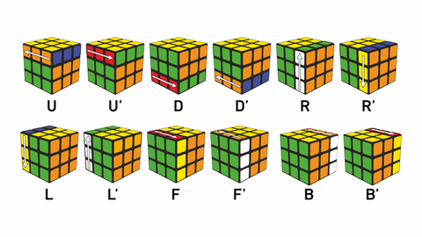
Solve Rubik’s Cube
Overview
Participants are challenged to design and implement an algorithm that can solve a standard 3x3 Rubik’s Cube from any scrambled state. The solution must mimic the real-world logic of solving a cube through a sequence of valid moves.
What We’re Looking For : 🔍
Problem-Solving Approach
How do you break down the problem?
How do you model the cube’s state and transitions?
Use of Data Structures
How do you represent the cube internally (e.g., arrays, trees, graphs)?
Use of efficient structures to track states and operations.
State Prediction Logic
Ability to track and predict cube state after each move.
Design of a move engine to simulate rotations and track permutations.
Algorithm Efficiency
How fast can your solution reach the solved state?
Complexity (time and space) of your algorithm.
Bonus Evaluation Areas
Creativity in solution design.
Visual simulation or cube UI (optional but Wow factor).
Scalability for different cube sizes (2x2, 4x4, etc.) : Optional
Deliverables:
Working algorithm (code)
Brief walkthrough/presentation of your approach
Output example(s) from your solver
It’s Not Just a Puzzle - It’s a Test of Mind, Math, and Moves!

Slide 4
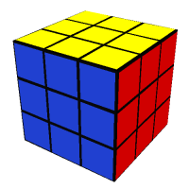
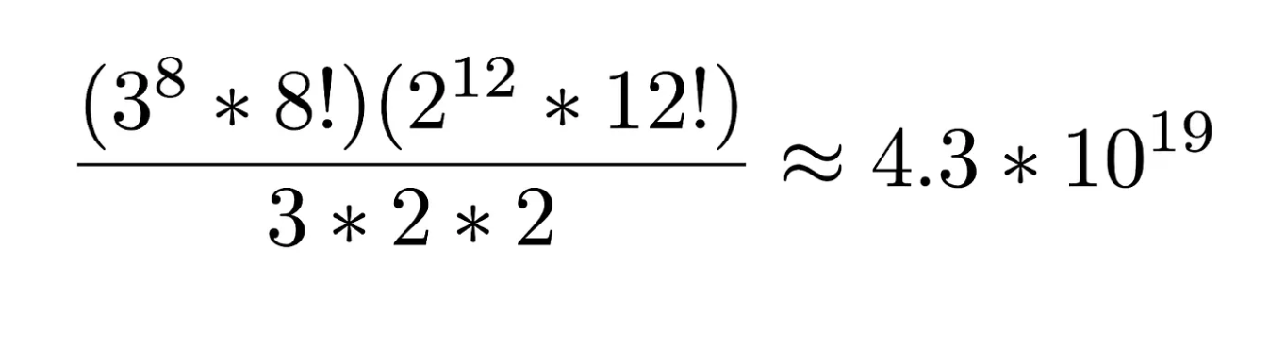
Understanding Rubik’s Cube
Ernõ Rubik, a professor from Hungary, invented the Rubik’s Cube in 1974.
The puzzle offers a great challenge. This is because there are approximately forty-three quintillion possible states the cube can be in, and only one correct solution.
This number is obtained by knowing that 8 corner cuboids can be rotated in three different ways, and 12 edge cuboids can be rotated in 2 different ways.
It took the inventor a month to figure out how to solve the magic cube.

Slide 5
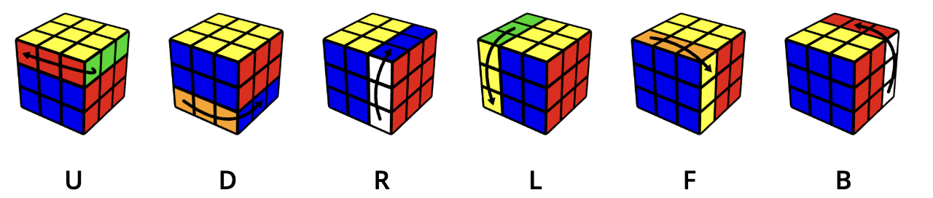
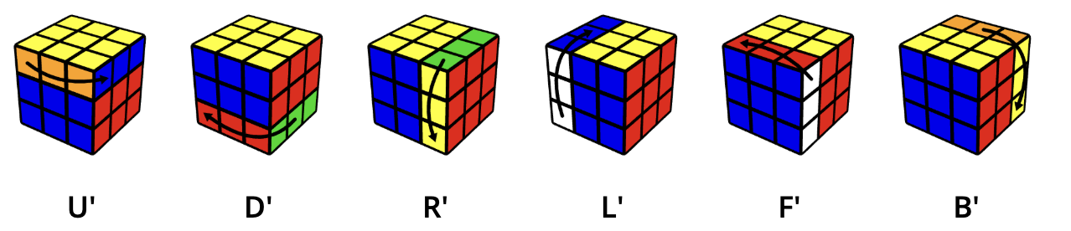
Understanding Notations
The basic moves are Up, Down, Right, Left, Front, Back.
Each move means to turn that side clockwise, as if you were facing that side.
An apostrophe (pronounced as prime) means to turn the face in the opposite direction (counter clockwise).
The fastest time to solve a 3x3x3 rotating puzzle cube is 3.05 seconds, achieved by Xuanyi Geng

Slide 6
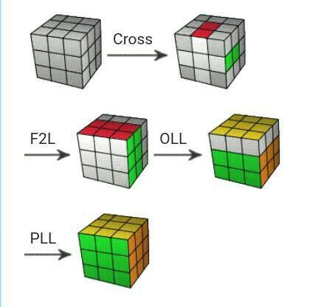
How do speedcubers solve a Rubik's Cube?
Speedcubers solve a Rubik's cube primarily using advanced methods like CFOP (also known as the Fridrich method)
The CFOP method to solve the Rubik’s Cube consists of four main steps:
Cross: Solve a cross on one face by aligning the edge pieces with the correct centre pieces, usually forming a "+" on the white face.
F2L (First Two Layers): Simultaneously solve the first two layers by pairing up corner and edge pieces and inserting them together, making this process faster than solving layers separately.
OLL (Orientation of the Last Layer): Use algorithms to orient all last-layer pieces so their top colour faces upward, regardless of their side positions.
PLL (Permutation of the Last Layer): Apply algorithms to move the last-layer pieces into their correct places, completing the cube’s solution
A speedcuber using CFOP can solve a cube in roughly 60 moves.

Slide 7
Approach
Modular CFOP Framework: Divided the solving process into four clear phases: Cross, F2L, OLL, and PLL, reflecting expert human speedcubing strategies.
Efficient Cube Representation: Encoded the cube state using seven 64-bit integers for rapid move simulation and compact storage.
Custom Move Encoding & Simulation: Used bitwise operations and well-defined enums to instantly apply and optimize moves, including slices and rotations.
Phase-specific Algorithms & Pattern Recognition: Implemented targeted algorithms for each phase with pattern-based recognition for OLL (29 cases) and PLL (21 cases) to automate solution steps effectively.

Slide 8
Intuitive Cross & F2L: Applied an intuitive, non-table-based approach to solving the cross and first two layers, enabling flexible and minimal-move placements.
Move Sequence Optimization: Merged redundant moves (e.g., R R → R2), eliminated unnecessary steps, producing human-readable and efficient output.
Cross-platform Interfaces: Supported both command-line and Web Assembly interfaces for wide accessibility and practical usability.
Robust Testing & Validation: Ensured 100% solve success over many random scrambles through rigorous testing and error handling at each solving stage.

Slide 9
Cube Representation
The most ingenious part of this implementation is how it represents the cube state. Instead of using a traditional 3D array, it uses seven 64-bit integers:
uint64_t stickers[7];
Why this design is brilliant:
6 Face Integers: Each of the first 6 integers represents one face of the cube
8 Stickers per Face: Each face stores 8 outer stickers (centre pieces don't move in basic solving)
8 Bits per Sticker: Each sticker colour is encoded in 8 bits
7th Integer for Centres: Allows for slice moves and wide turns by tracking centre positions
Bit Layout in 64-bit Integer:
| sticker0 | sticker1 | sticker2 | sticker3 | sticker4 | sticker5 | sticker6 | sticker7 |
| 8bits | 8bits | 8bits | 8bits | 8bits | 8bits | 8bits | 8bits |

Slide 10
Move Engine
Bitwise Move Simulation: Each cube move—whether a face turn, slice, wide move, or cube rotation—is simulated instantly using efficient bit manipulation on seven 64-bit integers that represent the cube’s state.
Comprehensive Move Set: The engine supports all standard face turns (U, D, L, R, F, B), double moves, wide turns, slice moves (M, E, S), and cube rotations (x, y, z), ensuring complete move coverage seen in real solves.
Move Representation & Encoding: Moves are encoded as enums specifying both the piece (face/slice/rotation) and move type (normal, prime, double), allowing precise application and easy manipulation within the code.
Adjacent Move Optimization: The engine merges or cancels adjacent redundant moves (e.g., R R → R2, R R' → NO_MOVE) during solution optimization, making the sequence shorter and more human-readable.
State Validation & Tracking: After every move, the cube state is updated and validated for integrity, ensuring the data remains consistent. Snapshots and operations allow for easy backtracking or further manipulation as required by the solver phases

Slide 11
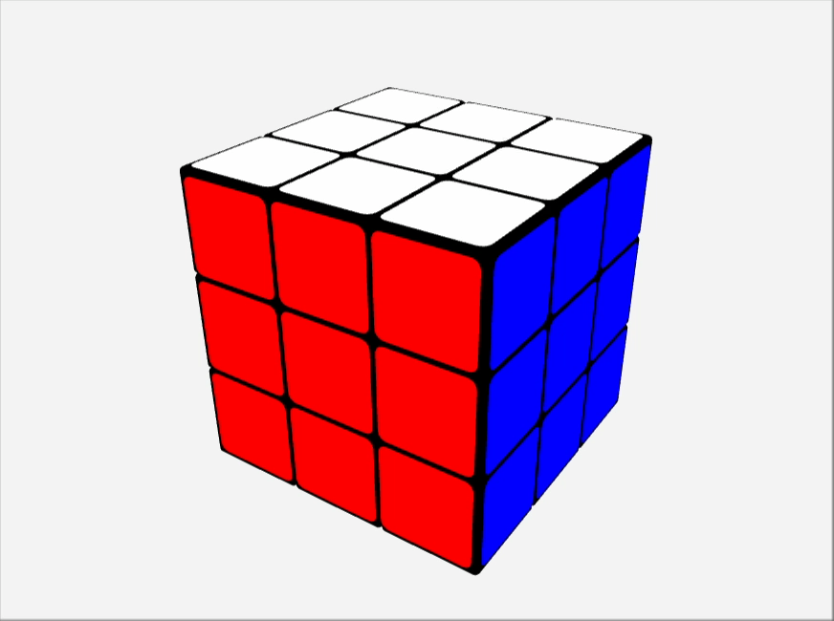
Pseudocode for a move operation
function rotateUpFaceClockwise():
// Rotate Up face by 90° clockwise
rotatedUp = rotateRight(getFace(UP), 16)
setFace(UP, rotatedUp)
// Save top row of FRONT face
temp = getFace(FRONT) & upMask
// Cycle top rows: FRONT <- RIGHT
setFace(FRONT, (getFace(FRONT) & ~upMask) | (getFace(RIGHT) & upMask))
// RIGHT <- BACK
setFace(RIGHT, (getFace(RIGHT) & ~upMask) | (getFace(BACK) & upMask))
// BACK <- LEFT
setFace(BACK, (getFace(BACK) & ~upMask) | (getFace(LEFT) & upMask))
// LEFT <- saved FRONT
setFace(LEFT, (getFace(LEFT) & ~upMask) | temp)
Caption : Up operation is executed in this way

Slide 12
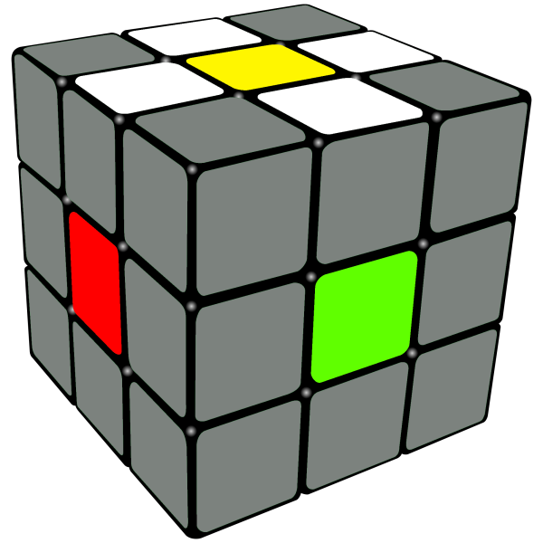
Solving Algorithm (CFOP)
1. Cross Phase ( SolverCross.cpp )
Goal: Create a cross on the bottom face
Process:
Finds all four edge pieces that belong in the cross
Positions each edge piece correctly relative to its centre
Handles cases where edges are already in bottom layer vs. top layer
Uses intuitive solving approach rather than lookup tables

Slide 13
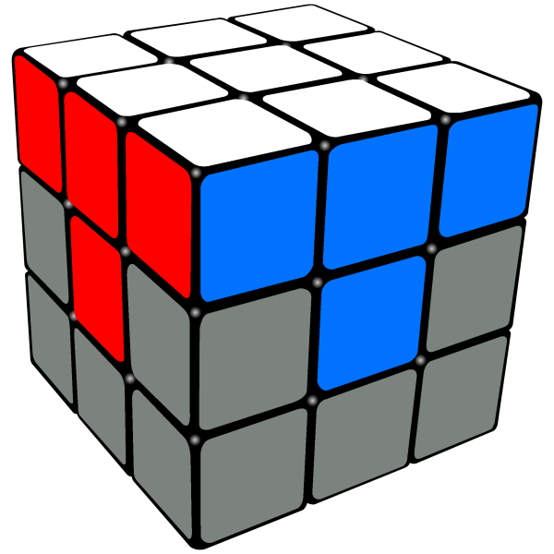
2. F2L Phase (SolverF2L.cpp)
Goal: Solve First Two Layers simultaneously
Process:
Key Techniques:
Solves corner-edge pairs one at a time
For each pair: Locates the corner and edge pieces
Brings them to the top layer if needed
Pairs them up (if not already paired)
Inserts the pair into the correct slot in the bottom two layers
Different algorithms for different pair configurations
Handles cases where pieces are already in F2L slots
Uses rotation to position pairs optimally

Slide 14
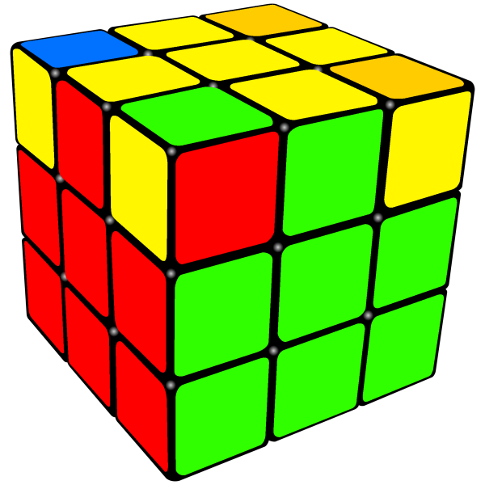
3. OLL Phase (SolverOLL.cpp)
Goal: Orient all last layer pieces (make top face one colour)
Implementation:
Algorithm Examples:
Contains 29 different OLL case types covering all 57 OLL algorithms
Uses bit patterns to identify which OLL case is present
Each case type has specific solving functions
(e.g., solveOCLL12(), solveT12())
T1/T2 Cases : "(R U R' U') (R' F R F')"
OLL 21 : "R U2 R' U' R U' R'"
Anti-Sune : "R U2 R2 U' R2 U' R2 U2 R"

Slide 15
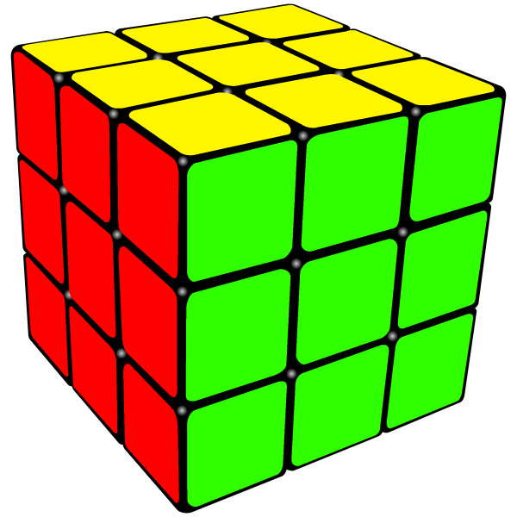
4. PLL Phase (SolverPLL.cpp)
Goal: Permute (position) all last layer pieces
Implementation:
Recognizes all 21 PLL cases using pattern matching
Uses lookup tables for PLL patterns and corresponding algorithms
Handles both edge and corner permutations
CUBE SOLVED !

Slide 16
Algorithm Efficiency
Time Complexity
Cross : O(n) where n is typically small (4-12 moves)
F2L : O(4n) for 4 pairs, each taking O(n) moves
OLL : O(1)lookup +O(k) execution where k ≤20 moves
PLL : O(1)lookup +O(k) execution where k ≤20 moves
Solution Quality
Average Length : ~70 moves (half-turn metric)
Success Rate : 100% (has never failed in testing)
Comparison to Optimal : ~3.5×optimal (God's Number is 20)
Comparison to Humans : Very competitive with human CFOP solvers
Space Complexity
Cube State : O(1)-fixed 7 ×64-bit integers
Solution Storage : O(n) where n is solution length (~70 moves)
Algorithm Storage : O(1)-fixed lookup tables

Slide 17
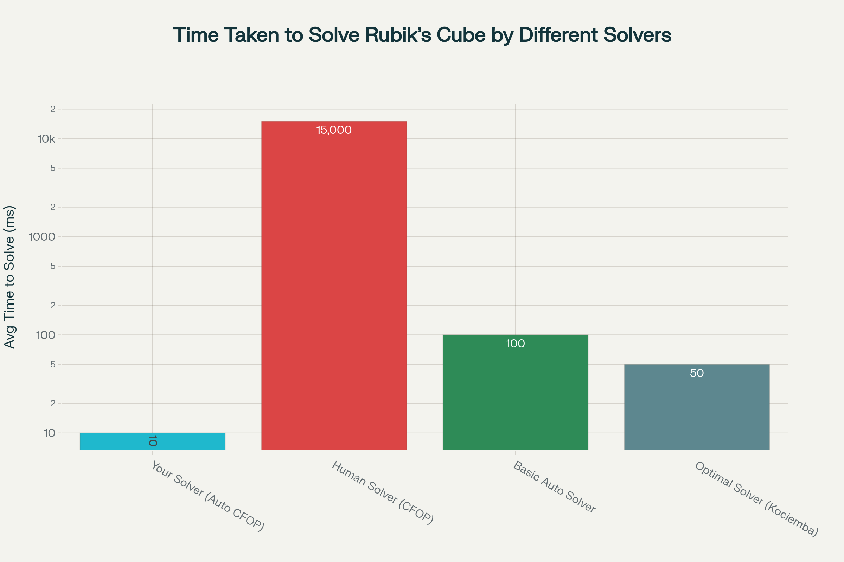
Caption : Bar chart showing average time taken by different Rubik's Cube solvers in milliseconds with log scale

Slide 18
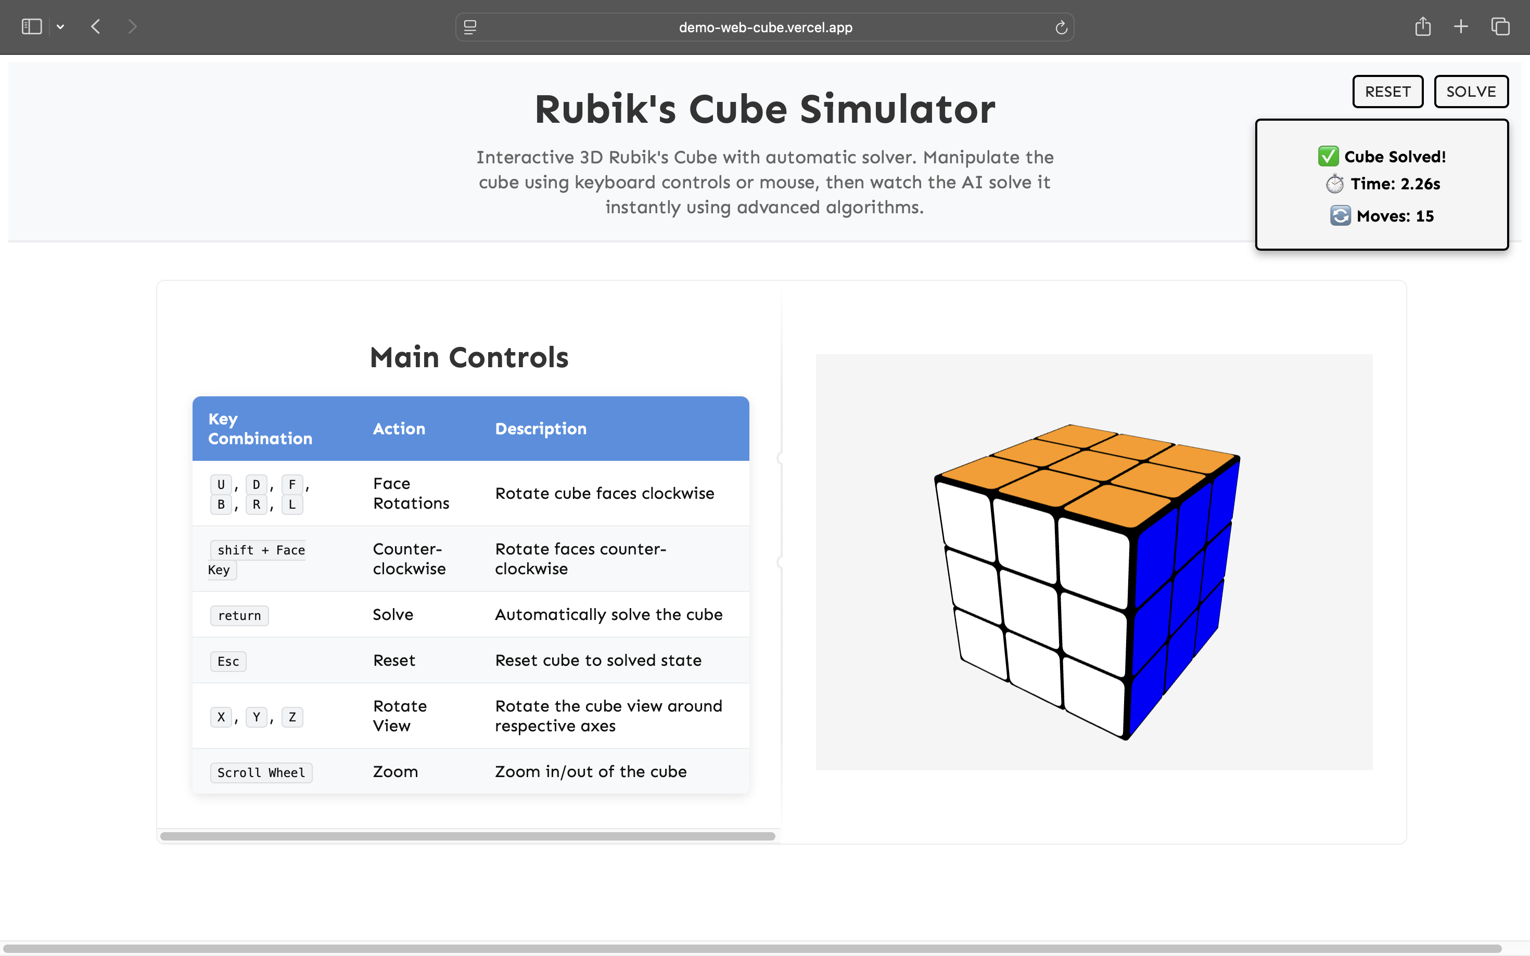
Web Interface
https://demo-web-cube.vercel.app/

Slide 19
Web Integration
C++ solver compiled to WebAssembly (.wasm) using Emscripten for high performance.
Emscripten generates JavaScript glue code to load and interface with the .wasm module.
JavaScript calls solver functions to process cube states in real time.
Three.js visualizes and animates the cube and solution steps on the web page.
Entire solving and rendering runs fast and smoothly inside the browser, no plugins needed.
github for web interface - https://github.com/chintanlad10/demo-web-cube

Slide 20
Differentiating factor
Advanced Move Optimization: Implements smart cleaning of solutions by merging adjacent moves (e.g., R R → R2), removing redundant moves (R R' → NO_MOVE), and toggling between optimized and readable outputs.
Automatic Cross Colour Selection: Dynamically identifies the cross colour based on the scrambled cube’s bottom face, enabling flexible solving starting from any colour.
Robust Error Handling & Validation: Validates every move before execution, checks cube state integrity continuously, and verifies completion of each solving phase to ensure correctness.
Interactive Web Interface with Visual Simulation: Features a smooth web-based UI powered by WebAssembly and three.js that visually animates the cube and solution steps, enhancing user interaction and understanding.

Slide 21
Conclusion
This Rubik's Cube solver represents a sophisticated implementation that bridges the gap between algorithmic solving and human solving methods. By implementing the complete CFOP method with all its nuances, it achieves both realistic solution lengths and reliable performance.
The use of bit manipulation for efficient cube representation, comprehensive algorithm databases for OLL/PLL recognition, and careful optimization techniques makes this solver both fast and accurate. The dual interface (command-line and web) demonstrates the versatility of the implementation.
GitHub links - https://github.com/chintanlad10/demo-solver
https://github.com/chintanlad10/demo-web-cube
Website - https://demo-web-cube.vercel.app/

Slide 22
References
https://in.speedcube.com.au/pages/how-to-solve-a-rubiks-cube
https://jperm.net/3x3/moves
https://medium.com/@brad.hodkinson2/writing-code-to-solve-a-rubiks-cube-7bf9c08de01f
https://www.guinnessworldrecords.com/world-records/72863-fastest-time-to-solve-a-rubiks-cube
https://www.learnhowtosolvearubikscube.com/how-to-solve-a-rubiks-cube-solution-overview
https://solvethecube.com/speedcubing
https://en.wikipedia.org/wiki/Optimal_solutions_for_the_Rubik%27s_Cube
https://medium.com/@benjamin.botto/implementing-an-optimal-rubiks-cube-solver-using-korf-s-algorithm-bf750b332cf9

